Slide 1
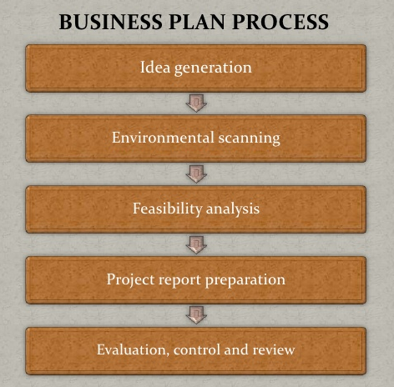
The Business Plan
Creating and Starting The Venture

Slide 2
Planning as Part of The Business Operation
Planning is a process than never ends for a business.
As the venture grow up to mature business, planning will continue …

Slide 3
What is a Business Plan?
A business plan is a written document prepared by the entrepreneur that describes all the relevant internal and external elements and strategies for starting a new venture.
It is a integration of functional plans such as marketing, finance, manufacturing, sales and human resources.

Slide 4
Who should write the plan?
The business plan should be prepared by the entrepreneur.
The entrepreneur may consult with many other sources in its preparation, such as lawyers, accountants, marketing consultants, and engineers.

Slide 5
Who Reads The Plans?
The business plan may be read by employees, investors, bankers, venture capitalists, suppliers, customers, advisors, and consultants.
There are three perspectives should be considered in preparing the plan :
  Perspective of the entrepreneur
  Marketing perspective
  Investor’s perspective

Slide 6
Why Have a Business Plan?
The business plan is valuable to the entrepreneur, potential investors, or even new personnel, who are trying to familiarize themselves with the venture, it goals, and objectives.
  It helps determine the viability of the venture in a designated market
  It provides guidance to the entrepreneur in organizing his or her planning activities
  It serves as an important tool in helping to obtain financing.

Slide 7
Presenting The Plan
It is often necessary for an entrepreneur to orally present the business plan before an audience of potential investors.
In this typical forum the entrepreneur would be expected to provide a short (perhaps 20-minutes or half-hour) presentation of the business plan.

Slide 8
Information Needs
Before committing time and energy to preparing a business plan, the entrepreneur should do a quick feasibility study of the business concept to see whether there a any possible barriers to success.
Internet can be a valuable resource.

Slide 9
Outline of a Business Plan
Introductory Page
  Name and address of business
  Name(s) and address(es) of principal(s)
  Nature of business
  Statement of financing needed
  Statement of confidentially of report

Slide 10
Outline …
Executive Summary – Three to four pages summarizing the complete business plan
  What is the business concept or model?
  How is this business concept or model unique?
  Who are the individuals starting this business?
  How will they make money and how much?

Slide 11
Outline …
Environmental and Industry Analysis
  Future outlook and trends
  Analysis of competitors
  Market segmentation
  Industry and market forecasts
Description of Venture
  Product(s)
  Service(s)
  Size of business
  Office equipment and personnel
  Background of entrepreneurs

Slide 12
Outline …
Production Plan
  Manufacturing process (amount subcontracted)
  Physical plant
  Machinery and equipment
  Names of suppliers of raw materials
Operational Plan
  Description of company’s operations
  Flow of orders for goods and/or services
  Technology utilization

Slide 13
Outline …
Marketing Plan
  Pricing
  Distribution
  Promotion
  Product forecasts
  Controls
Organizational Plan
  Form of ownership
  Identification of partners or principal shareholders
  Authority of principals
  Management-team background
  Roles and responsibilities of members of organization

Slide 14
Outline …
Assessment of Risk
  Evaluate weakness of business
  New technologies
  Contingency Plans
Financial Plan
  Pro forma income statement
  Cash flow projections
  Pro forma balance sheet
  Break-even analysis
  Sources and applications of funds

Slide 15
Outline …
Appendix (contains backup material)
  Letters
  Market research data
  Leases or contracts
  Price lists from suppliers.

Slide 16
Using and Implementing The Business Plan
The business plan is designed to guide the entrepreneur through the first year of operations.
Implementation of the strategy contain control point to ascertain progress and to initiate contingency plan if necessary.
Business plan not end up in a drawer somewhere once the financing has been attained and the business launched.

Slide 17
Measuring Plan Progress
Entrepreneur should check the profit and loss statement, cash flow projections, and information on inventory, production, quality, sales, collection of accounts receivable, and disbursements for the previous month.
  Inventory control
  Production control
  Quality control
  Sales control
  Disbursements

Slide 18
Updating the Plan
The most effective business plan can become out-of-date if condition change.
If the change are likely to affect the business plan, the entrepreneur should determine what revisions are needed.
In this manner, the entrepreneur can maintain reasonable targets and goals and keep the new venture on a course that will increase probability of success.

Slide 19
Why Some
Business Plans Fail
Goals set by the entrepreneur are unreasonable.
Goals are not measurable
The entrepreneur has not made a total commitment to the business or to the family.
The entrepreneur has no experience in the planned business.
The entrepreneur has no sense of potential threats or weaknesses to the business.
No customer need was established for the proposed product or service.

